Slide 1
Macroeconomic Data Report (2000 - 2010)
Faisal Alrajhi
ECO 202
Michael Tasto

Slide 2
Ten-Year Period of U.S. Economic History Overview
Economic period between 2000 and 2010.
U.S Economy experienced great recession.
GDP was greatly impacted.
Unemployment was impacted.
Notes:
The ten-year old period of U.S economic history that I chose is the period between 200 and 2010. During this period, different economic activities took place in the U.S economy. However, the great recession that took place between December 2007 to June 2009 caught my attention. It has been my desire to practically study more about the business cycles with close examination of the different periods. Economic recessions is generally the period in which the economy contracts with most of the businesses within the economy get less demand and loss a lot of money. The great recession mainly impacted the GDP and unemployment. The U.S GDP declined by 0.3% in 2008 and 2.8% in 2009. On the other hand, the recession period saw the unemployment rate reach 10% (Su, 2001).

Slide 3
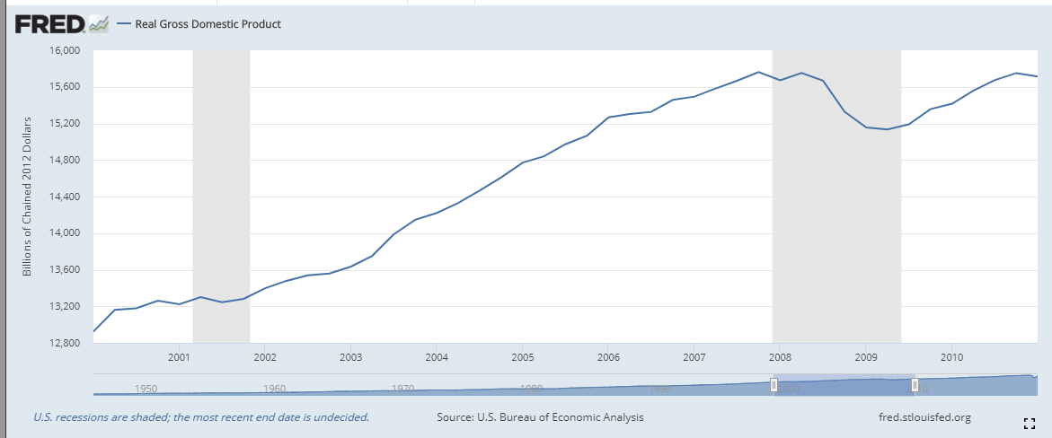
GDP
  Growth rate = (12924.179 - 15750.625)/15750.625 = -17.95%
  2000 to 2007, booming economy
  2007 to 2009 great recession
  2009 to 2010 booming economy.
  The us housing bubble lead to great recession.
  Liquidity in global markets lead to great recession.
  Improved investment lead to the increased GDP instances.
Notes:
The period 2000 to 2010 overall had a negative GDP growth rate which generally implies that the US economy was more of contracting than expanding FRED. (2020). The expansion that was experienced during this period was as a result of correction of the great recession experienced hence ending up having a negative growth rate. Generally the business sales during this period as contracted. The graph depicts that the great recession occurred from 2007 to 2009 while the other years the economy was booming. There are various activities that resulted to the GDP treated during this historic period. For instance, the collapse of the U.S housing market which was caused by unregulated use of directives. The housing prices peaked in early 2006 and started to decline towards end of 2006 and start of 2007 hence resulting to the great recession. The subprime mortgage crisis resulted to severe contraction of the liquidity in the global crisis. However, the US economy never collapsed due to the all time increased investments.

Slide 4
Unemployment and Inflation
    Inflation rate = (1.640043442389890 -3.376857271499350 )/3.376857271499350 = -51.43%
    Inflation rate is calculated through the change in consumer price index.
    Unemployment rate is calculated by dividing the total unemployment people with labor force for a specific period of time.
    High inflation lower GDP growth.
    High unemployment lowers GDP.
    Collapse of the U.S housing market increased inflation and unemployment rate.
Notes:
A negative inflation rate was experienced in the period between 2000 and 2010. This is an indication that the prices during the period mostly were falling hence resulting to contraction of the economy. In mist cases this was as result of higher supply of good than the market demand. Also, the deflation experienced could be as a result of buying power of money becoming greater. Inflation generally is calculated through the change in consumer price index over a certain period while unemployment is calculated by diving the total unemployment population with the labor force. High inflation rate usually tend to make investments less profitable (Su, 2001). Therefore, inflation discourages or lowers investment hence resulting to lower GDP growth. The same case applied to unemployment since higher rates of unemployment tend to lower the GDP growth. The previous selected event that is the collapse of the housing market in 2007 resulted to increased inflation and unemployment rate hence decreasing GDP growth (Couture & Handbury, 2017).

Slide 5
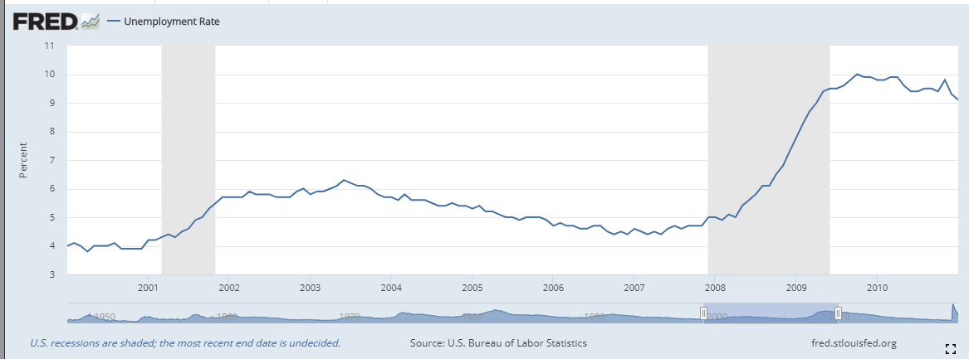
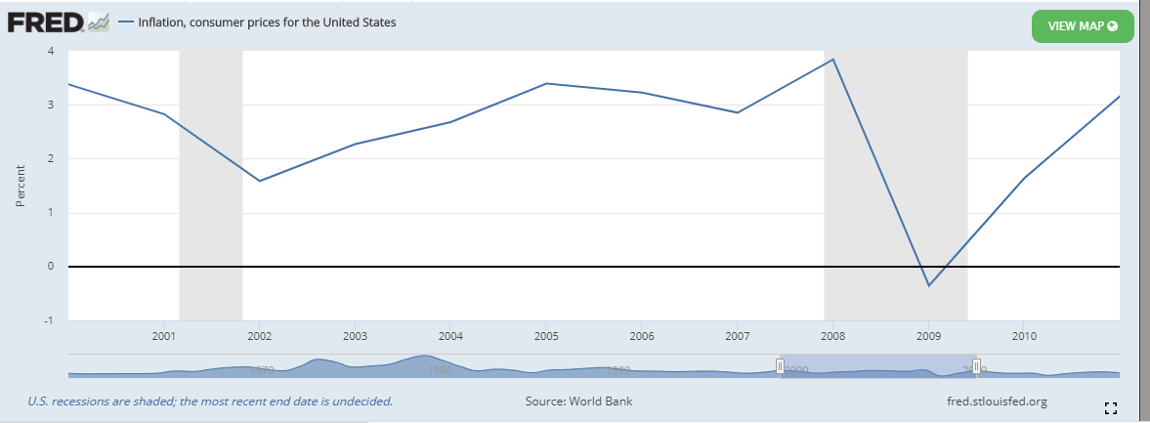
Unemployment and Inflation
Notes:
The above figures are unemployment and inflation graphs respectively for the years 2000 to 2010 FRED. (2020).

Slide 6
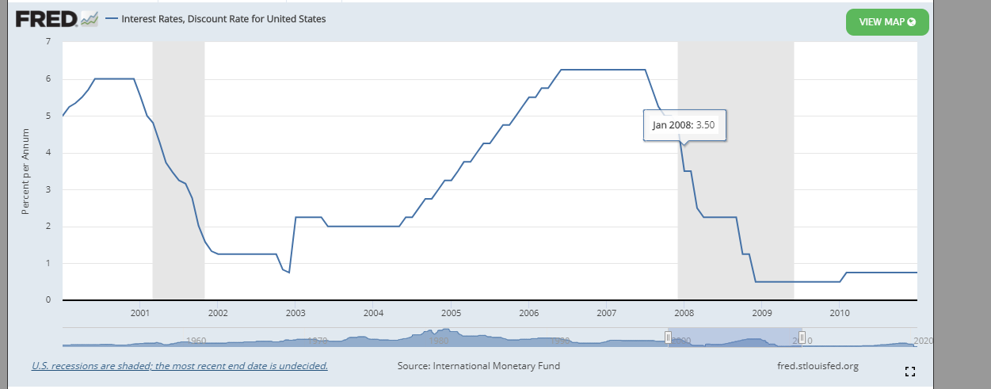
Interest Rates
High of 6.25 in 2000, 2006 and 2007 and low of 0.75 in 2002 and 2009.
Inflation could lead to low interest rates
Increase in interest rates would reduce investments and foreign trade rates.
Average interest rates would result to increased real GDP.
Notes:
The interest rates in the period between 2000 and 2010 greatly fluctuates reaching its highest point of 6.25 in 2000, 2006 and 2007 and its lowest point of 0.75 in 2002 and 2009 FRED. (2020). There was steady decrease in the interest rates in the period when the economy faced great recessions making the interest rate reach its minimum. This was due to the contraction nature of the economy during the great recession. The fluctuations in interest rates had different impacts on the economy pillars. One major contributor to the interest rates fluctuations could be inflation . High rates of inflation could result to reduced interest rates. Also, interest rates fluctuations could greatly impact investments and foreign trade rates. High rates of interest rates would likely reduce the investment and foreign trade rates. Lastly, interest rates fluctuations also during this period impacted the U.S GDP to a greater extend. Read GDP would increase when average interest rates are achieved (Tomaskovic-Devey et al., 2011).

Slide 7
References
Couture, V., & Handbury, J. (2017). Urban revival in America, 2000 to 2010 (No. w24084). National Bureau of Economic Research.
FRED. (2020). Federal Reserve Economic Data | FRED | St. Louis Fed. https://fred.stlouisfed.org/
Tomaskovic-Devey, D., & Lin, K. H. (2011). Income dynamics, economic rents, and the financialization of the US economy. American Sociological Review, 76(4), 538-559.
Su, B. W. (2001). The US economy to 2010. Monthly Lab. Rev., 124, 3.

